Slide 1


Big Data Learning Path – Progress Presentation
Name: Pettem Akhilvarsh
Roll.no: 24075A6710

Slide 2





Learning Journey Overview
Introduction to Business Intelligence
Data-driven decision making and analytics foundations
Introduction to NoSQL Databases
Modern database systems for scalable applications
Essentials of Cloud Computing
Infrastructure, platforms, and cloud-native solutions
Introduction to Python
Programming fundamentals for data processing
Big Data 101
Hadoop ecosystem and distributed computing concepts

Slide 3

Business Intelligence Mastery
Core Concepts Mastered
Data Types & Structures
BI delivers the right information, at the right time, to the right person
Structured data in traditional databases
Semi-structured data (JSON, XML)
OLTP vs OLAP architectural differences
Unstructured data handling techniques
Data warehouse design principles
Skills gained: Business analysis capabilities, decision-making support systems, and strategic data interpretation
Data quality frameworks and validation

Slide 4
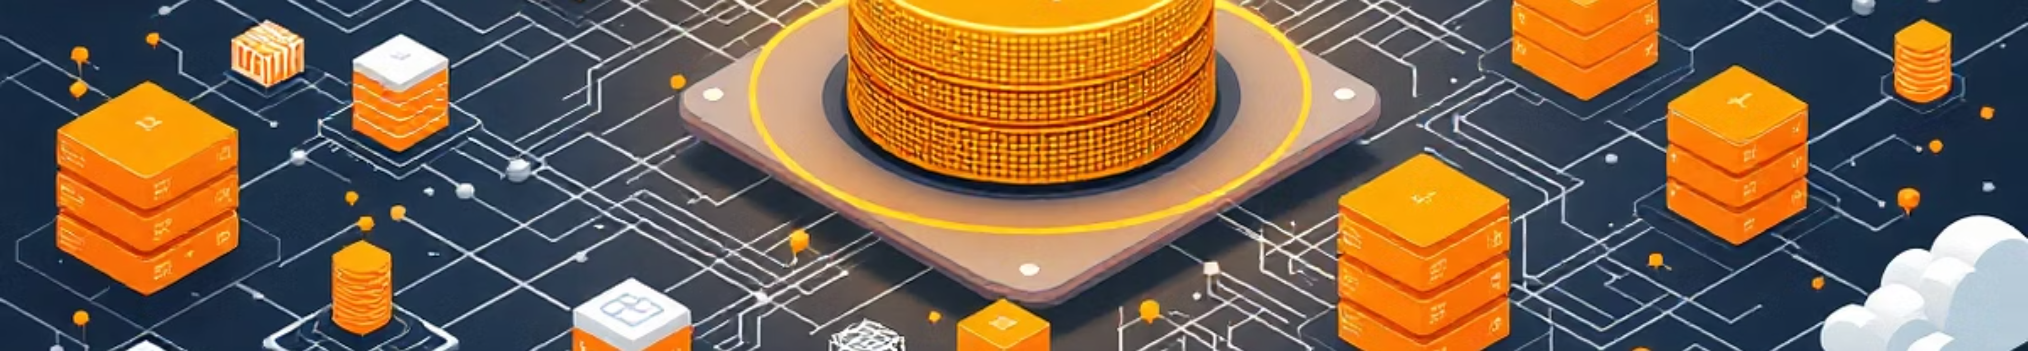
NoSQL Database Expertise
Key-Value Stores
Document Databases
Redis, DynamoDB for high-performance caching and simple data structures
MongoDB, CouchDB for flexible schema and JSON-like documents
Columnar Databases
Graph Databases
Cassandra, HBase for time-series and analytical workloads
Neo4j for relationship-heavy data and network analysis
Mastered the CAP theorem trade-offs between Consistency, Availability, and Partition Tolerance for optimal database selection

Slide 5




Cloud Computing Foundations
Service Models
Infrastructure as a Service (IaaS), Platform as a Service (PaaS), and Software as a Service (SaaS) - understanding when and how to leverage each model
Deployment Strategies
Public, Private, Hybrid, and Community cloud models with security considerations and cost optimization strategies
Modern Technologies
Virtualization fundamentals, Docker containerization, Kubernetes orchestration, and serverless computing paradigms

Slide 6


Python Programming Proficiency
Programming Fundamentals
Advanced Concepts
Control structures and conditional logic
Libraries and module integration
Function design and modular programming
Data collections: lists, dictionaries, sets
Code organization best practices
File I/O operations and data persistence
Exception handling and error management
Data processing workflows
Skills gained: Python programming for data processing, analysis, and automation - essential for big data workflows

Slide 7








Big Data Ecosystem Mastery
Volume
Velocity
Handling petabytes of data across distributed systems
Real-time processing and streaming data pipelines
Veracity
Variety
Data quality, accuracy, and trustworthiness validation
Structured, semi-structured, and unstructured data formats
Comprehensive understanding of the Hadoop ecosystem: HDFS for distributed storage, MapReduce for parallel processing, YARN for resource management, plus Hive and Pig for data querying

Slide 8

Integrated Learning Outcomes
01
Data Capture
Understanding various data sources and ingestion methods across different systems and platforms
02
Data Storage
Selecting appropriate storage solutions - from traditional RDBMS to NoSQL and distributed file systems
03
Data Processing
Applying big data frameworks and cloud computing resources for scalable data transformation
04
Data Analysis
Leveraging BI tools and programming languages to extract actionable insights from complex datasets

Slide 9





Next Phase: Advanced Specialization
Java Programming Fundamentals
Enterprise-level programming for scalable big data applications
Introduction to R
Statistical computing and advanced data analysis capabilities
Data Management Associate Certification
Industry-recognized expertise in data governance and management
Big Data 301
Advanced distributed computing and real-world implementation projects

Slide 10


Thank You
Ready to apply these foundational skills to real-world big data challenges and continue advancing through the comprehensive learning pathway.

